Slide 1

Lensless Digital Holographic Microscope
Group 7
Notes:
-Parker

Slide 2
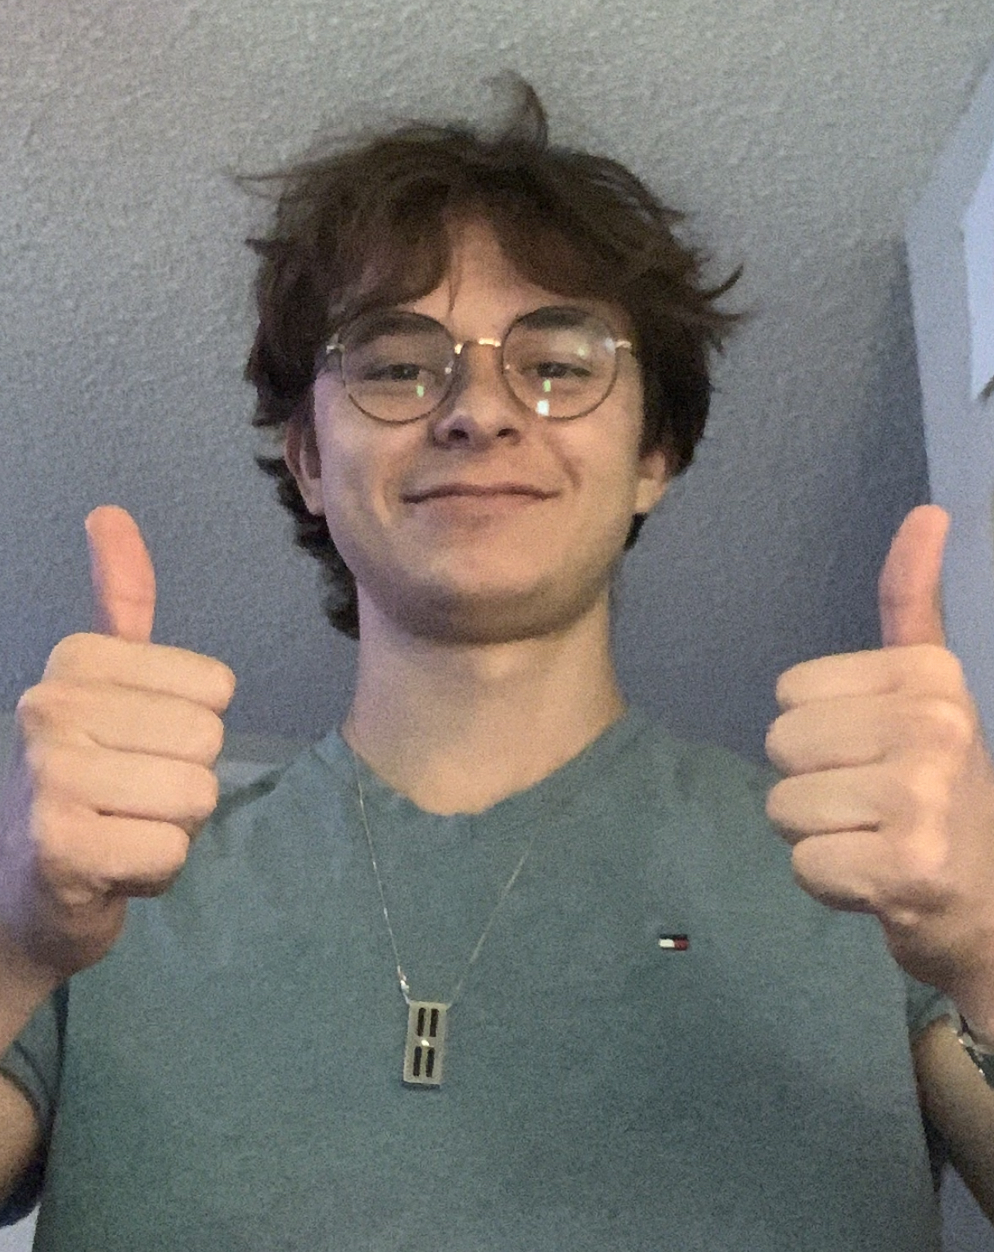
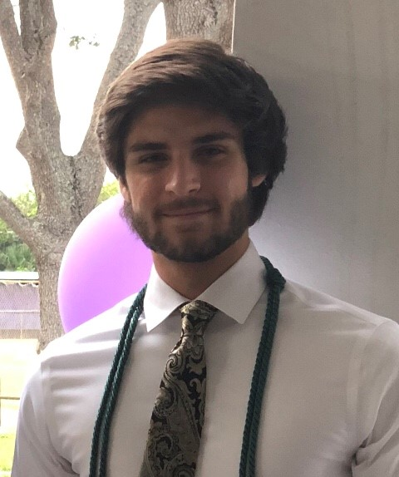
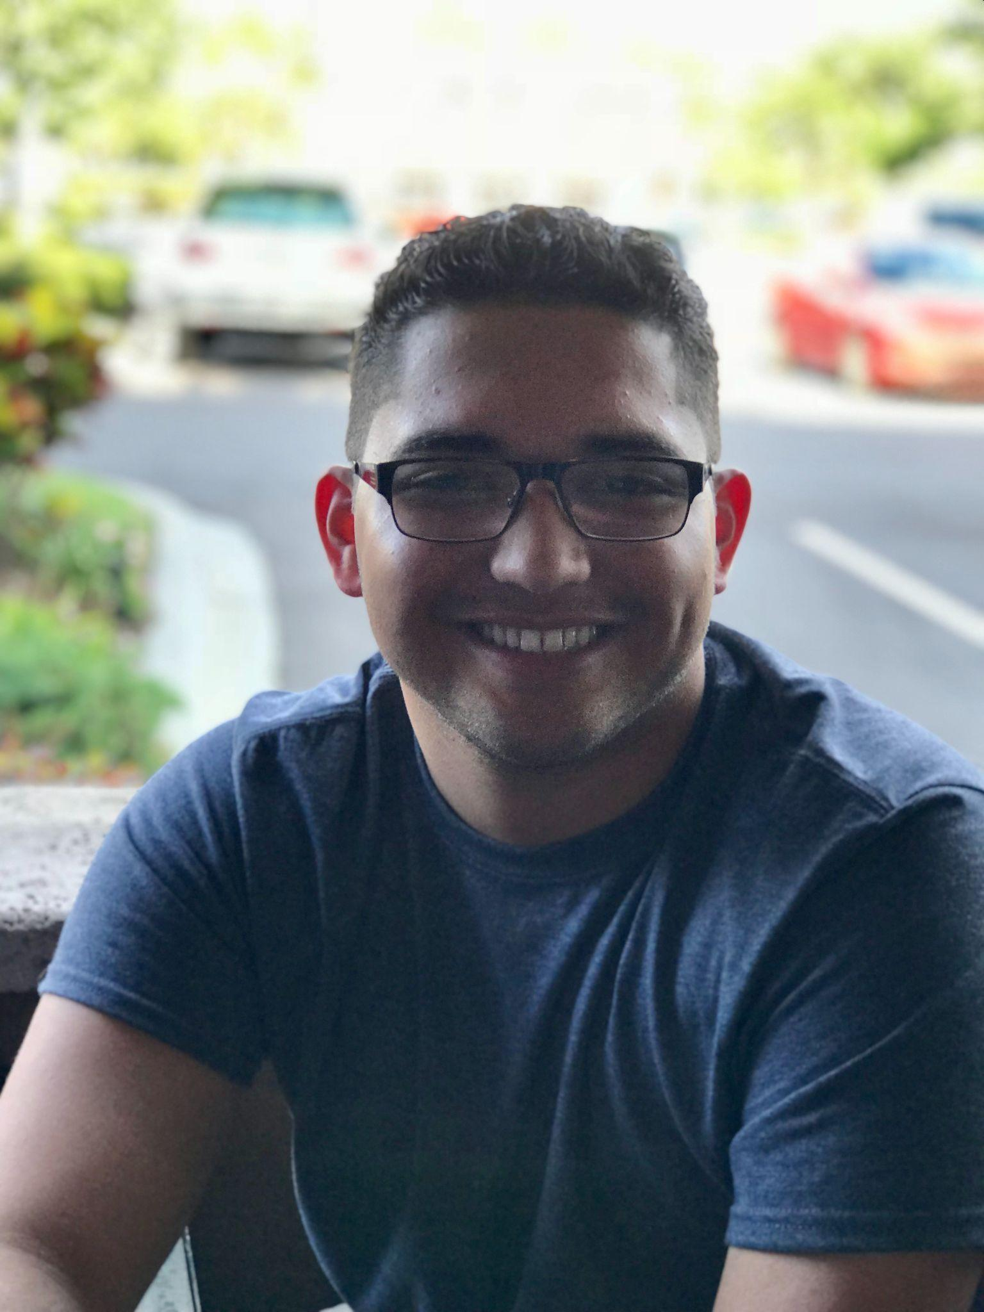
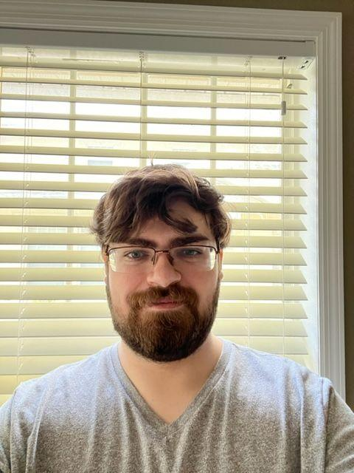
Meet Our Team - Group 7
Nicolas Bonaduce
Photonics Engineer
Parker Crooks
Photonics Engineer
Julian Correa
Computer Engineer
Nick Scarlata Electrical Engineer
Notes:
-Parker

Slide 3
Project Description
Lensless microscope that digitally images onto a smartphone or a computer application
  The imaging will be constructed using back-propagation and shift-and-add pixel super-resolution of in-line holograms captured on a CMOS Sensor.
  Done using fiber optics and an LED array to slightly shift the attack angle of the incoming light onto a semi-transparent sample.
Notes:
-Parker

Slide 4
Motivations
Microscopes are costly and unwieldy.
  Unit size will be smaller and cheaper to manufacture than commonly used microscopes.
Field work with microscopes is difficult.
  With it’s compact size, it can be taken into the field to image.
Smoother and cheaper introduction to optical microscopy.
  Students engaging in optical studies can take this microscope anywhere and will allow for smaller financial burden if damaged.
Notes:
-Parker

Slide 5
Goals and Objectives
Core Goals:
  Demonstrate viability in digital lensless microscopy
  Image at the 250 micrometer level
  Program a microcontroller to communicate with the optical device.
Advanced Goals:
  Image at the 150 micrometer level
  iOS application integration
Stretch Goals:
  Image something at the 50 micrometer level
  Implement scalability (create multiple)
  Set different presets for different test subjects
Notes:
-Parker

Slide 6
Goals and Objectives cont.
Objectives:
  Couple LED array into Fiber Optic Array efficiently
  Sequentially set off the LED’s at variable timing (To image in sync w/ CMOS Sensor)
  Calculate formulas for different wavelengths/image-subjects into an excel chart for variable imaging.
  Ensure CMOS works well with a variety of softwares
  Program PSR/Gabor Algorithms
  Ensure power supply falls in line with current goal. (Computer/iPhone)
Notes:
-Parker

Slide 7
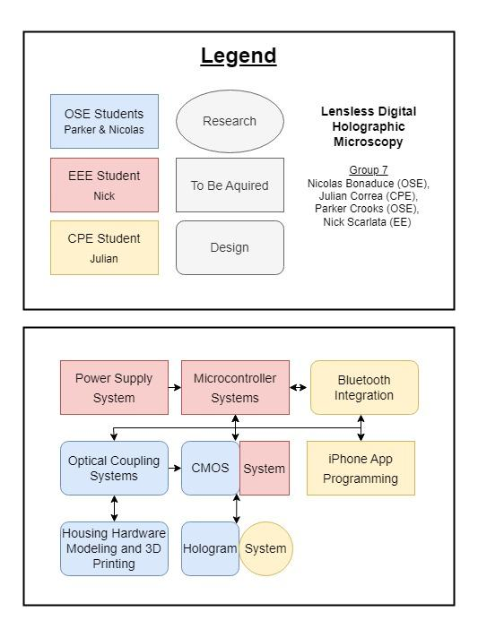
Block Diagram
The following diagram represents the distribution of responsibilities between the group members. The legend outlines the colors and shapes used in the block diagram.
Notes:
-Parker

Slide 8
Project Specifications & Requirements
Engineering Requirements | Values
Cost | >$800
Power | <10V
Microcontroller | <40s latency while being able to control the system
Optics | Can visualize a subject between <250 µm
App | <60s latency
CMOS Sensor | Pixel size of >3x3 µm
LEDs | An array of 25 at 220 lumens
Notes:
-Parker

Slide 9
Software Goals
Goals
Implement phase retrieval with the use of deep learning
Have the ability to generate an in-line hologram/ Gabor Hologram
Create a focused image with the use of simple backpropagation in order to create a focused and defocused image (two-image artifact)
Implement the “shift-and-add” in order to take low-resolution holograms and up-sample, shift, and digitally add them in order to create a good image
Implement digital hologram reconstruction (digital back-propagation) with the method of angular spectrum method
Notes:
-mauricio

Slide 10
Software Design Approach
Data transmission and processing:
Be able to transmit the images from the CMOS Sensor to the computer to use the algorithms and principles in order to get a image to show
MATLAB:
Use for testing and creation of algorithms and equations
Coding:
The coding for the CMOS Sensor and its algorithms will be done in python
Microcontroller coding will be done in C
Notes:
-Mauricio

Slide 11
Photonic Methods and Principles
Gerchberg Saxton Algorithm
Holography and Digital In-Line Holography
  Gabor in-line holography
Propagation and Back-Propagation
Angular Spectrum Method
Pixel Super-Resolution
Spatial Convolution
Phase Retrieval
Pixel Pitch
Notes:
-mauricio

Slide 12

Optical Design
Notes:
Title page for the section

Slide 13
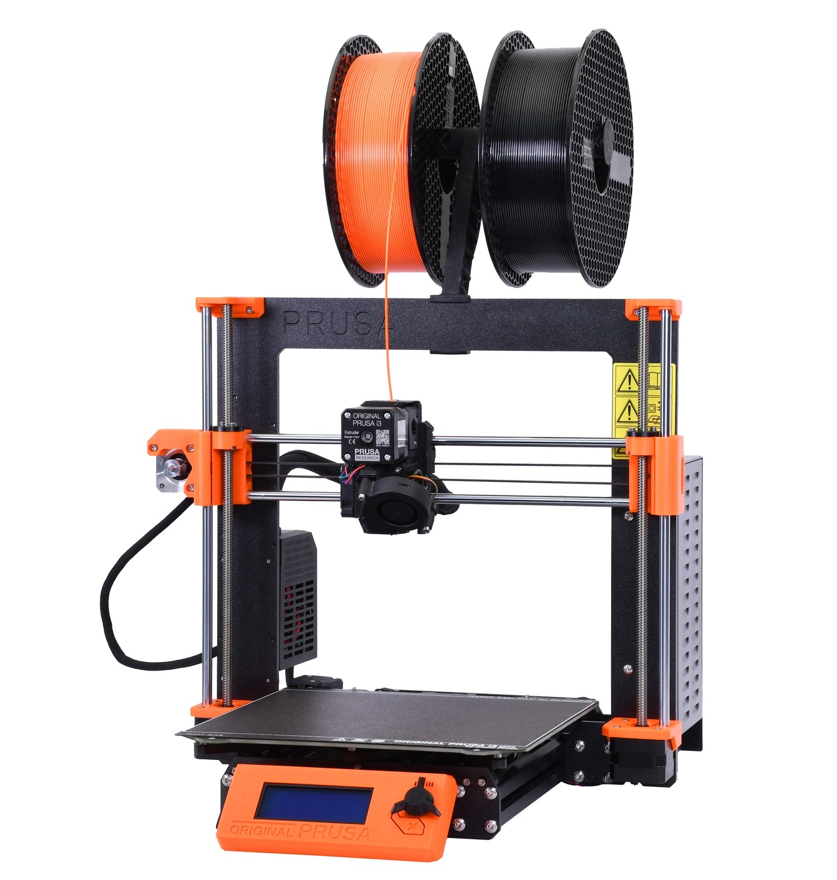
Housing Unit, LED tuning, and Fiber Holders
Fully encompass all the components of our microscope.
Ideal size would fit inside a pocket for
  ease of access,
  cheap manufacturing
  portability.
We will be 3D printing the housing unit because of the printer’s quick turnaround time, plastic’s durability, customization, and low cost of material.
Prusa i3 3D Printer
Notes:
-nico or parker

Slide 14
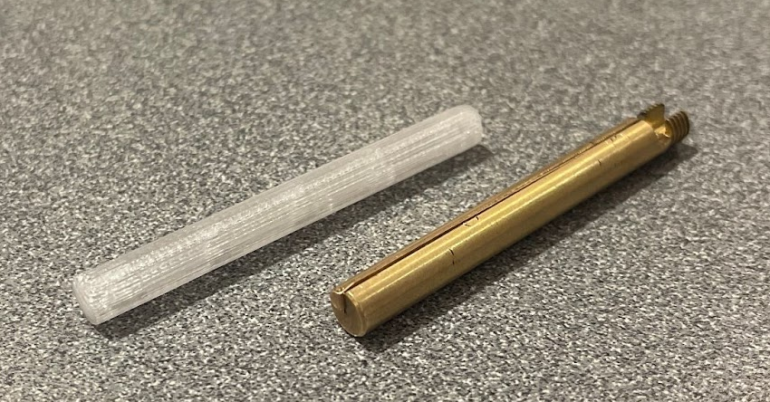
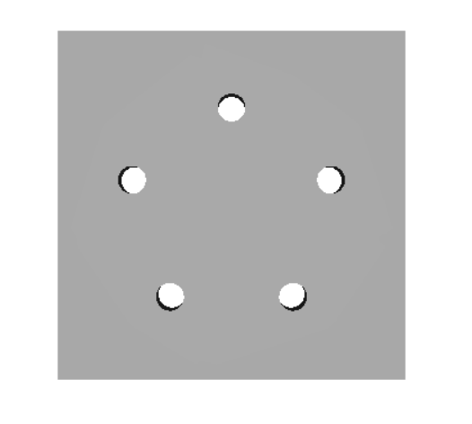
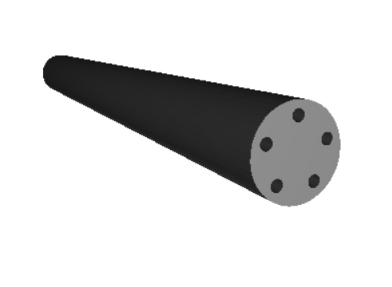
Fiber Holders
We will have our own printed fiber holders so that the fibers themselves can be arranged in an array format.
One fiber chuck will have up to five fibers equidistant from the center.
The locations of the fibers will be known, which will allow utilization of the shift and add software.
Notes:
-nico or parker

Slide 15
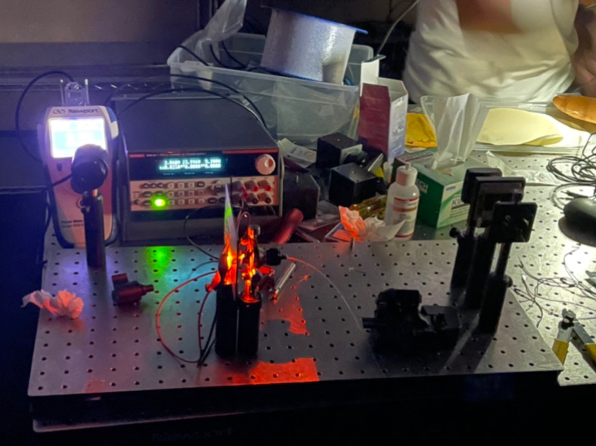
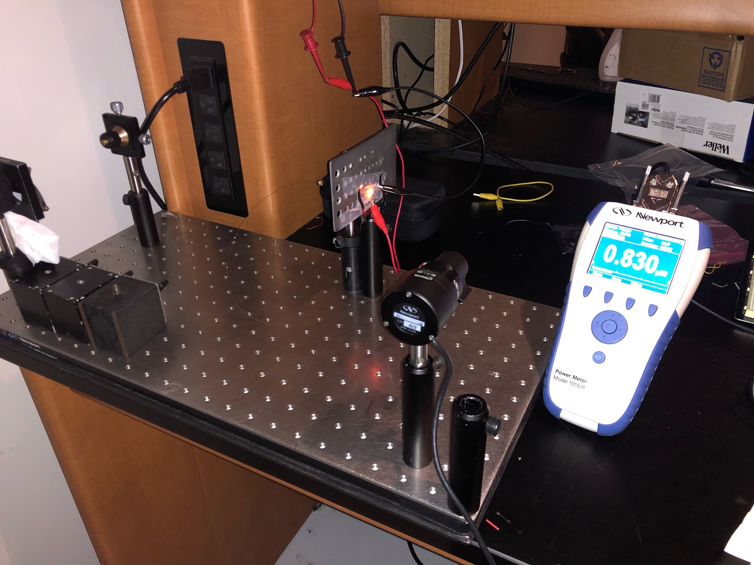
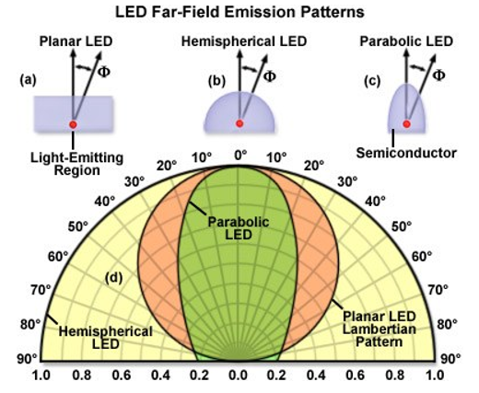
Optical Demonstration 1
Notes:
-nico or parker

Slide 16
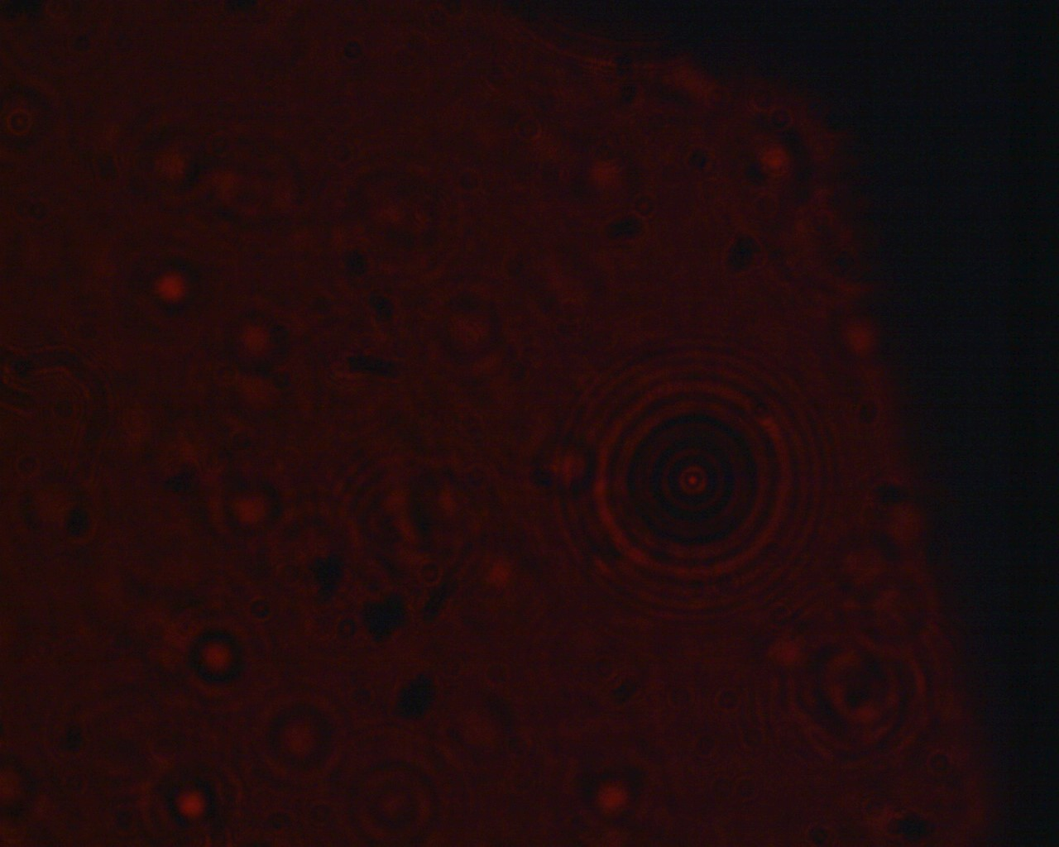
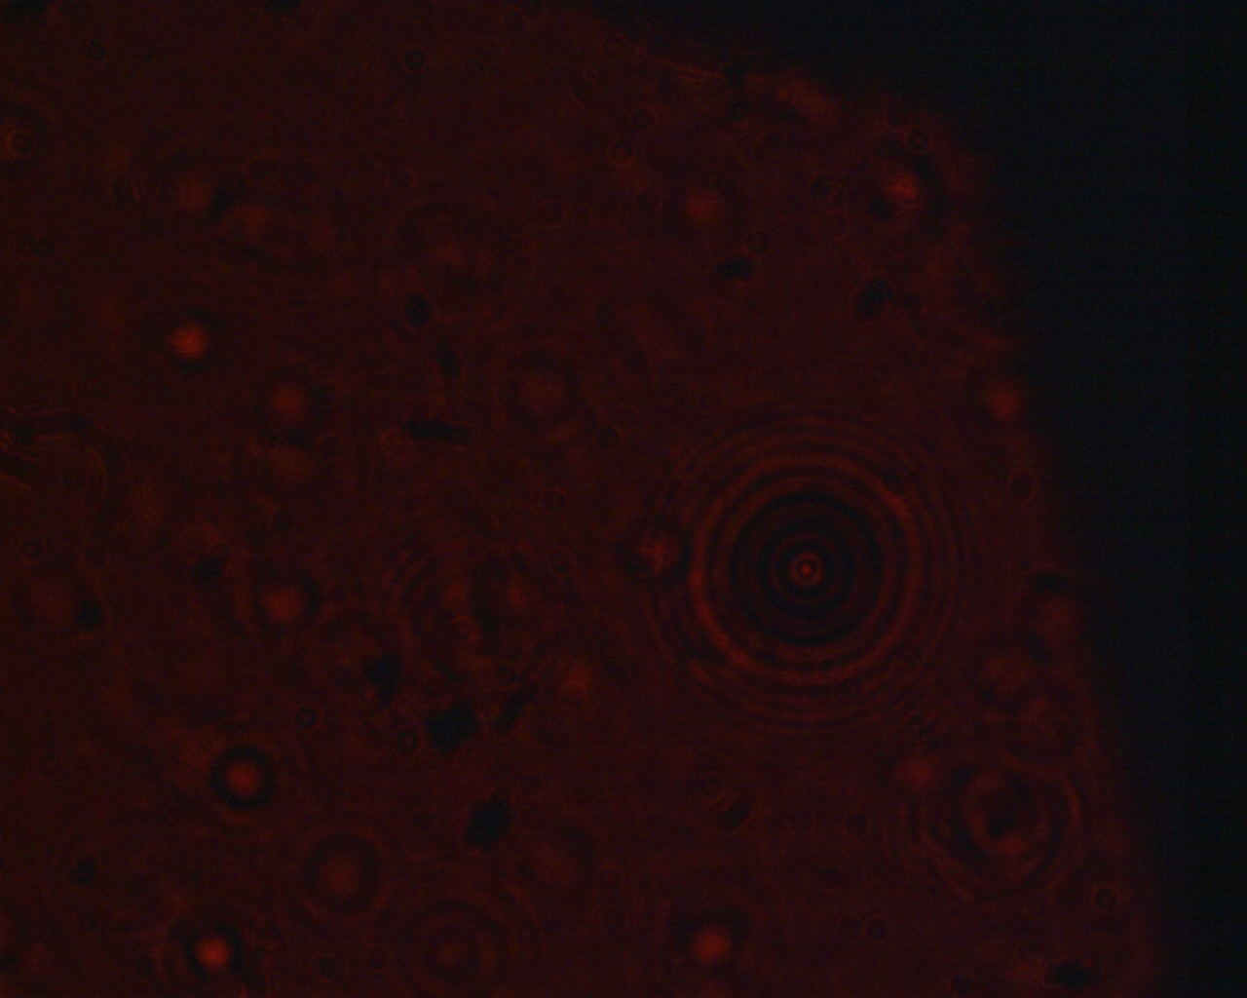
Optical Demonstration 2
Notes:
-nico or parker

Slide 17
Electrical Design
Notes:
Title page for the section

Slide 18
Electrical Goals and Objectives
Goals
Have a source of power either on board or using the device it is mounted to for power
Find a reasonable CMOS sensor
Find a microcontroller that can accomplish the tasks of the device
LEDs (25)
Objectives
Find a reasonable power source for all the electrical components
Ensure the wiring of said components is correct according to a PCB diagram
Notes:
-nick

Slide 19
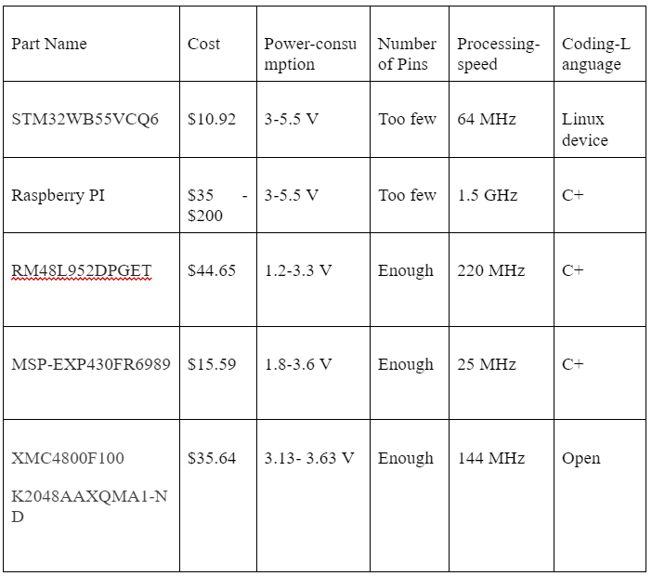
Microcontrollers
These are the microcontrollers that we looked into.
The focus was on cost while being able to accomplish the tasks of:
Image processing
Controlling the LED array
A dual microcontroller system was then chosen.
Notes:
-Nick

Slide 20
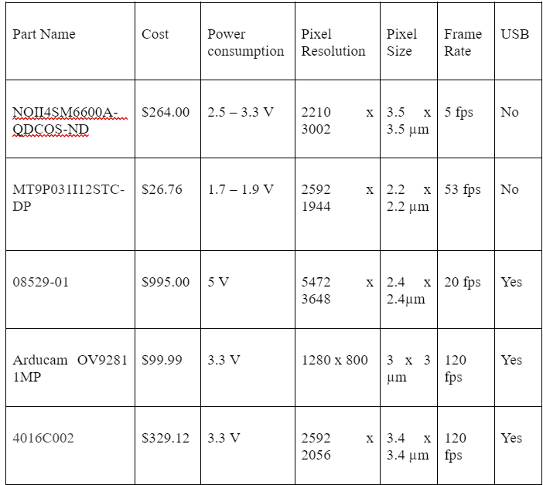
CMOS sensor
After initial research minimizing cost here would be difficult.
An appropriate pixel size was the most important aspect of the CMOS sensor.
The decision here would eventually go to the 4016C002, this component of a standard CANON camera, as the current front runner.
Notes:
-Nick

Slide 21
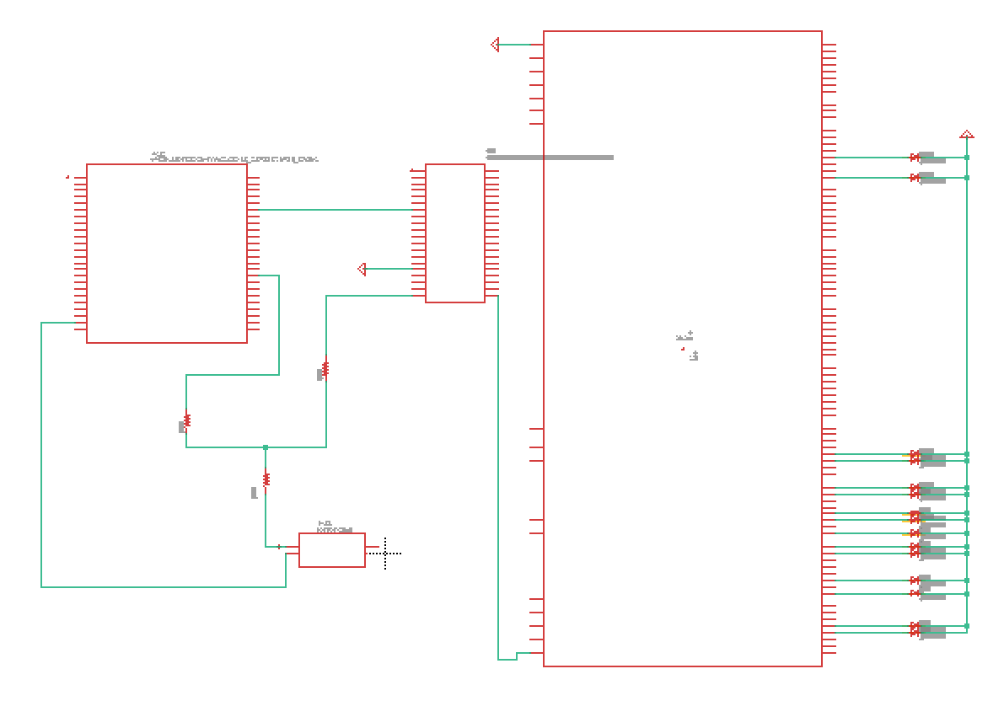
Circuit Design
From left to right:
CMOS sensor
Power source
Raspberry PI
MSP430
LED array
Notes:
-Nick

Slide 22
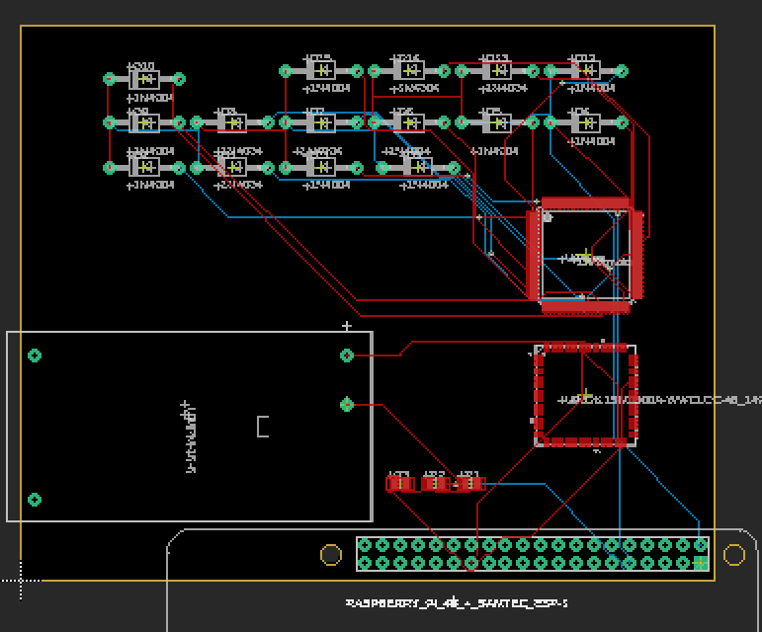
PCB
The Free Version of Eagle has a size restriction.
The diodes will be in a proper array outside of the PCB.
Also all the Raspberry PIs are the same to the PCB so the one here is the only version I could find.
Notes:
-Nick

Slide 23
Constraints
These constraints help highlight the various concerns and limitations that play a crucial role in part of the schedule and the selection of parts that make up our project,
Economic
  Self funded by group
Environmental
  Having microcontrollers and CMOS sensors all RoHS (Restriction on the use of Hazardous Substances) compliant
Social
  Affordability
Ethical
  Does not infringe on any existing projects and patents
Health & Safety
  Eye health and safety
  Electrical components connections
Manufacturability
  Availability of parts
Sustainability
  using RoHS approved parts
Time
  Length of the Semester
  Testing parts
  Delivery Time for parts
  Individual schedules
Notes:
-mauricio

Slide 24
Standards
LEDs
LEDs have radiation emission limits as per the FCC. Between 30MHz and 10000 MHz. LED suppliers must also fill out FCC Supplier Declaration of Conformity (SDoC) Heavy metal limits. Florida is one state that *does* regulate the amount of heavy metals in LEDs
C language
ISO/IEC 9899:2011 which specifies the form, structure, and establishes the interpretation of programs that are written with the C programming language
Electronic Components
Following the RoHS Directive
Photonic Components
IEEE Photonics Society which covers the the scope of which is to cover standards in areas that are : lasers, optical devices, optical fibers, and associated lightwave technology and their applications in systems and subsystems, in which the quantum electronic devices are key elements. We will also be following Laser safety standards set by OSHA and ANSI standards for laser us
Notes:
-Mauricio

Slide 25
Project Budget
Component Quantity | Quantity | Total Cost
LEDs | 25 | TBD
Small amount of multimode fiber | TBD | TBD
Fiber Chucks | Approx. 8 | 3D Printed
Fiber Clamper | 1 | TBD
Fiber Cleaning Wipes and Alcohol | 1 | TBD
UV Resin | 2 | $19.99
UV Flashlight | 1 | $6.99
Microcontroller | 2 | $15.50 + $35.00
CMOS Sensor | 1 | TBD
Total ($) |  | TBD
Notes:
-Mauricio

Slide 26
Current Progress & Future Plans
Completed
Going Forward
Create a 3d printed fiber holders and design
Completed LED synchronization initial testing
Designed and completed initial PCBs with placeholder sensor and parts
The Raspberry PI had a few delays so that is a focus in the next few weeks
Finish the design of the housing unit
Purchase remaining parts
Decide on the CMOS sensor we are going to purchase
Code the photonic algorithms and principles
Code the phone application
Notes:
-mauricio

Slide 27



Project Management Tools
Texting and Group chats
Discord
Github
Notes:
-mauricio

Slide 28
Thank you for your time!
Any questions?
Notes:
-Nick since he had the last slide. Just say email us any questions.
Sounds good to me - Nick
Dope - Parker

